Slide 1


Advancing Regulatory Intelligence with Conversational and Generative AI SD-397
Solutions Development
May 19, 2024

Slide 2






Biographies
Rohit Kadam
Niketan Panchal
Rohit Kadam: Rohit Kadam is a Researcher at Tata Consultancy Services (TCS).
He is working with the TCS ADD Research and Innovation as a Researcher in R&I Team for nearly 3.5 years and contributed extensively to developing key solutions for TCS Healthcare Domain
Niketan Panchal works for TCS ADD Research and Innovation as a Researcher (TCS).
He has been with the TCS ADD Life Sciences Platform for about 3 years as a Researcher in the R&I Team. Niketan possesses Data Science skills.
Saurabh Das
Saurabh Das is part of Life Sciences, TCS ADD Platforms at Tata Consultancy Services (TCS).
In his current role, he is the Product Head of TCS ADD Analytics & Insights and also Heads the ADD Research and Innovation. He has over 17 years of experience in product development and managing large program executions. He has an in-depth understanding of system architecture and software landscape through experience in different business processes of large client projects spanning multi-tier, cloud and mobile applications.
Rajasekhar Gadde
Saroj Sah
Rajasekhar Gadde is a Researcher at TCS ADD Research and Innovation, working on the ADD Life Sciences Platform.
With over 3 years of experience at TCS, Rajasekhar is part of the Research and Innovation team, leveraging data science skills.
Saroj Sah is a Researcher at TCS ADD Research and Innovation unit, working with the ADD Life Sciences Platform.
With over 2.6 years of experience at TCS, he contributes his expertise in data science, and Gen AI skills to the Research and Innovation team

Slide 3







Introduction
Clinical trials are essential for evaluating the safety and efficacy of new medical treatments and interventions.
Personalized
medicine
Understand
diseases
Identify new treatment
Improving Patient Care
Over the years, the landscape of clinical trials has evolved significantly, driven by advancements in technology, changes in regulatory requirements, and the need for more efficient and ethical research practices.
Notes:
Hi Good evening everyone today we are going to talk about clinical trials and especially regulatory intelligence.
As we all know clinical trials are tests for new medicines treatments or medical devices, they are carefully designed experiments that helps scientists figure out if these new things are safe and effective.
Clinical trials helps in personalized medicines, understanding disease, identifying new treatments, improving patient care and many more.
But over the years trials are becoming more and more complex. The regulatory agencies are imposing more and more strict regulations and its becoming very difficult to manage these.

Slide 4

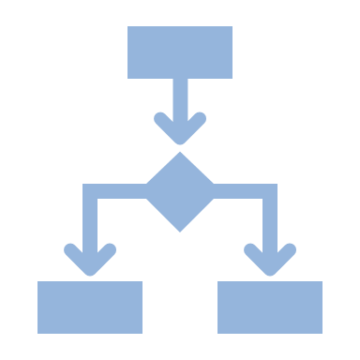



Regulatory Intelligence
Regulatory intelligence enables organizations to stay informed about changes in regulatory landscapes, anticipate potential impacts on their operations, and make informed decisions to ensure compliance with applicable requirements.
It involves systematic collection, analysis and application of regulatory information and insights to ensure compliance with regulatory requirements and optimize the design, conduct and approval of clinical trials.
Strategic and informed Decision Making
Risk Mitigation
Compliance
Process impacts to Investigational and current Products
Regulatory requirements for clinical trials are continuously evolving to adapt to advancements in science, technology, and changes in healthcare landscapes.
How clinical trials changed over time and regulatory changes affecting
Notes:
Regulatory agencies play a crucial role in clinical trials by ensuring that research is conducted ethically, safely, and with integrity. Regulatory intelligence involves staying up do date with the changes in regulatory space and identifying potential impacts on their operations.

Slide 5






Current Challenges
Knowledge Extraction
Information overload impacting interpretation and assessment
Integrating and maintaining timely compliance
Complex and evolving regulations
Resource and knowledge intensive

Slide 6




Changing Perspective
Business Context
Specialized knowledge
Contextual information
Guidelines
Regulations
Domain
Knowledge
Reliable
Consistent
Robust
Regulatory Intelligence Chatbot
Natural Interaction
Contextual Awareness
Accessibility
Scalability
Personalization
Multilingual Capabilities
Natural Language Processing
Text Generation
Information Retrieval
Knowledge Representation
Reasoning
Personalization
Conversational
AI
Generative
AI

Slide 7







Leverages NLP, ML, large datasets
Enables natural language interactions between humans and machines
Conversational
AI
Mimics human like speech
Provides users with intuitive interface
Create smarter, more humanized digital experience

Slide 8





Large Language models trained on massive text datasets
Understand human language and generate coherent, relevant text
Generative
AI
Learn complex linguistic patterns and structures
Comprehensive understanding of concepts
Can capture nuances of language, context and domain knowledge

Slide 9




High Level Architecture
NLU
Intent classification
Entity Extraction
Dialogue Management
Extracted entities +
User query
Input
Conversational Engine
Knowledge Repository
Data / Information lookup
User requests
Domain
User
Category/Sub-Category
Conversational AI + Generative AI
Resources / Actions
Response
Large Language Model
Retrieved Data / Information
Processed
data +
User query
Data Pre-processing
Output

Slide 10
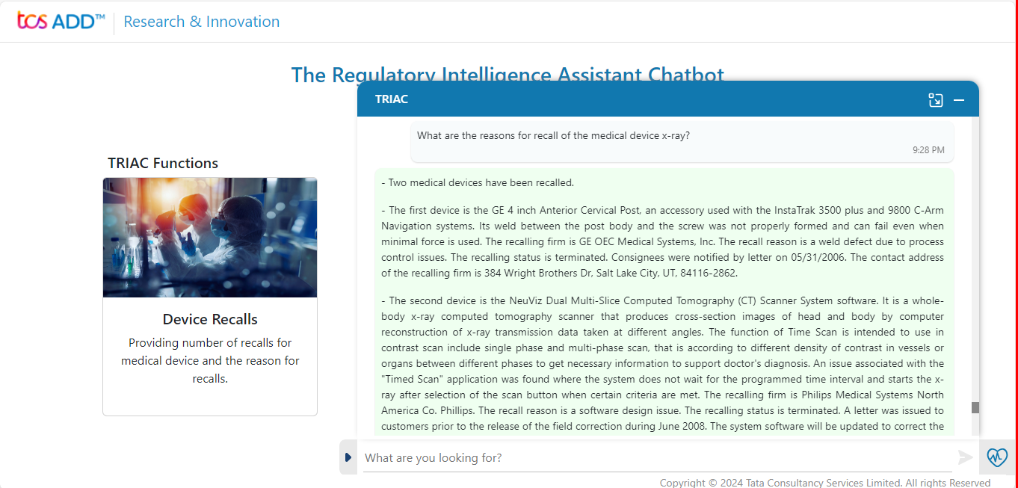
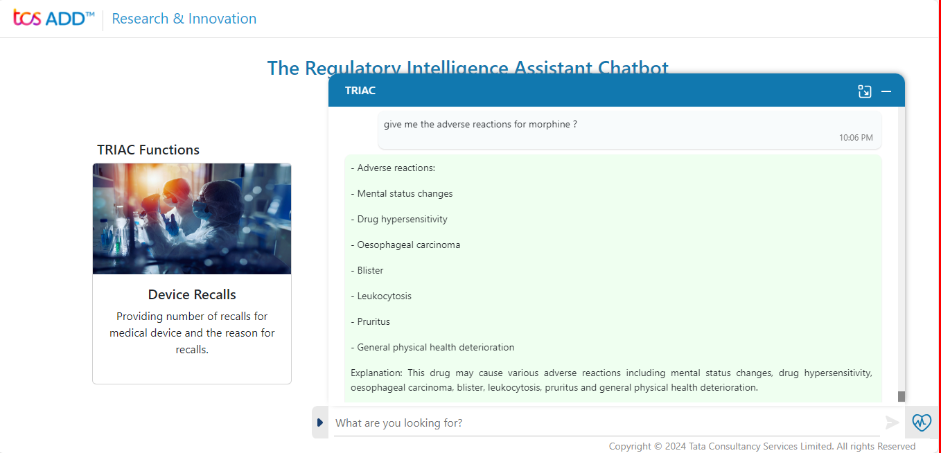
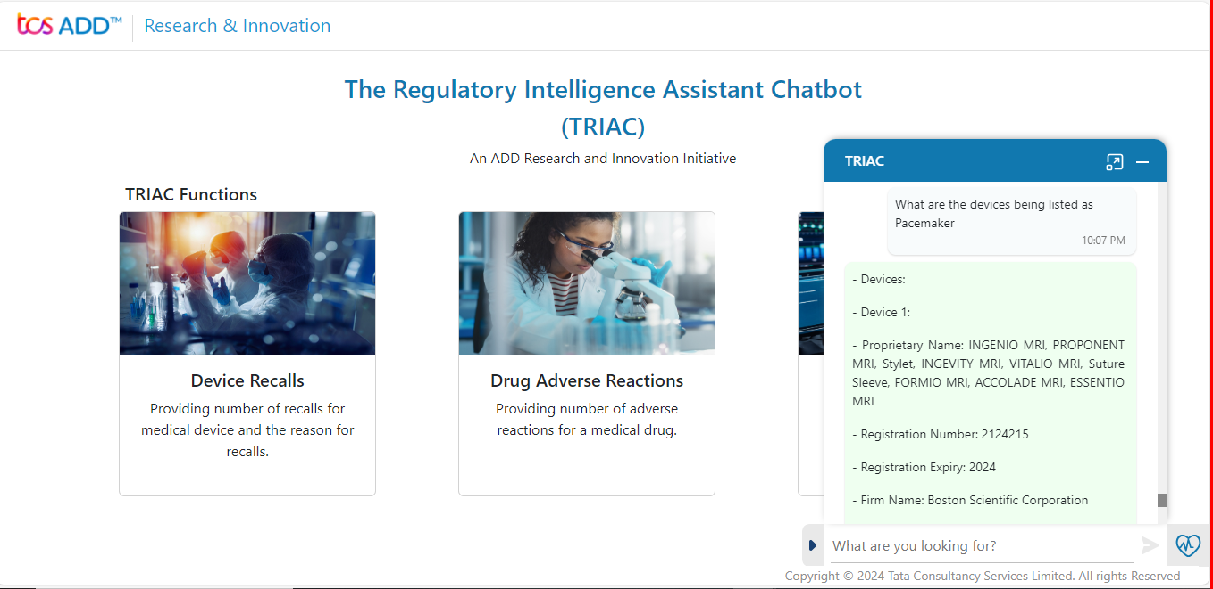
Screenshots:
Drug or Device recall data along with analysis and insights
Safety report and profile analysis of drug along with insights
Drug or Device Listing information with conversational insights

Slide 11





Shifting the Viewpoint
HARNESSING STRUCTURED/ UN-STRUCTURED CLINICAL REGULATORY INFORMATION
CONVERSATIONAL AI
+
GENERATIVE AI
ACCLERATING CLINICAL TRIAL DECISIONS
Streamlining the Regulatory Intelligence information using the advanced technologies of data ingestion, extraction and processing systems
Conversational capabilities +
Smarter insights with Generative AI. Providing upfront insights.
Identification of product specific regulatory changes and minimizing time for decision making, using intuitive user interaction
Incorporating regulatory information and Intelligence in business workflow faster and at right time.
Leveraging the insights to reveal impacts to clinical trial process and products.
Notes:
Retrospective analysis of unstructured Clinical Data
developed prognostic prediction models using information extracted from unstructured text in a data-driven manner
Pragmatic NLP algorithms can assist with identifying sites at high risk

Slide 12
Benefits
Addresses key challenges with data, knowledge extraction, and continuous evolving of data
Enables efficient and access to up-to-date regulatory information
Improved compliance, faster decision-making and better patient outcomes
Real-time updates on regulatory changes
Handles global variability of regulations

Slide 13



The Future of Regulatory Intelligence
Refining knowledge repository, improving contextual understanding
Ensuring seamless integration into existing workflows, maintaining compliance with data privacy regulations must be our next priority.
Ongoing adaptation to evolving regulatory landscapes are crucial for widespread adoption and usability
Gen AI based Regulatory Intelligence Chatbot
Helping pave way for new paradigm shift to better, compliant trials of future

Slide 14
Contact Us
Saurabh Das
Tata Consultancy Services;
Email: saurabh.das@tcs.com
Niketan Panchal
Tata Consultancy Services;
Email: niketan.panchal@tcs.com
Rohit Kadam
Tata Consultancy Services;
Email: kadam.rohit1@tcs.com
Rajasekhar Gadde
Tata Consultancy Services;
Email: rajasekhar.gadde@tcs.com
Saroj Sah
Tata Consultancy Services;
Email: sah.saroj@tcs.com

Slide 15
References
Taylor, Natasha. 2019. “Regulatory Intelligence: How AI will change regulatory operations.” Pharma iQ. September 24, 2019. https://www.pharma-iq.com/business-development/articles/regulatory-intelligence-how-ai-will-change-regulatory-operations.
Hall, Gloria. 2019. “Regulatory Intelligence, Risk Management and Drug Promotion.” Regulatory Focus. February 05, 2019. https://www.raps.org/news-and-articles/news-articles/2019/2/regulatory-intelligence-risk-management-and-drug
Vincins, Richard. 2019. “Managing Regulatory Intelligence for Medical Devices.” Regulatory Focus. January 29, 2019. https://www.raps.org/News-and-Articles/News-Articles/2019/1/Managing-Regulatory-Intelligence-for-Medical-Devic
Huddle, Emil. and Messmer, Kirsten. 2019. “Proactive Regulatory Intelligence Communication.” Regulatory Focus. January 24, 2019. https://www.raps.org/News-and-Articles/News-Articles/2019/1/Proactive-Regulatory-Intelligence-Communication
Kadam, Rohit. Das, Saurabh. Pachisia, Ashutosh. Panchal, Niketan. Ramachandran, Anita. Dr. Indani, Ashish. and Chaturvedi, Prashant. 2022. “The Future of Regulatory Intelligence With Conversational AI.” Applied Clinical Trials. May 24, 2022. https://www.appliedclinicaltrialsonline.com/view/the-future-of-regulatory-intelligence-with-conversational-ai
Kulkarni, P. Mahabaleshwarkar, A. Kulkarni, M. Sirsikar, N. and Gadgil, K. 2019. “Conversational AI: An Overview of Methodologies, Applications & Future Scope.” IEEE Xplore. https://ieeexplore.ieee.org/document/9129347
Naveed, Humza. Khan, Asad Ullah. Qiu, Shi. Saqib, Muhammad. Anwar, Saeed. Usman, Muhammad. Akhtar, Naveed. Barnes, Nick. and Mian, Ajmal. 2024. “A Comprehensive Overview of Large Language Models” arxiv February 20, 2024. https://arxiv.org/pdf/2307.06435.pdf

Slide 16


